Slide 1
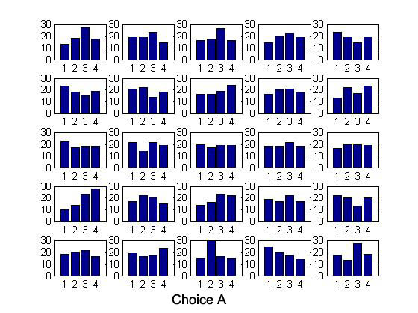
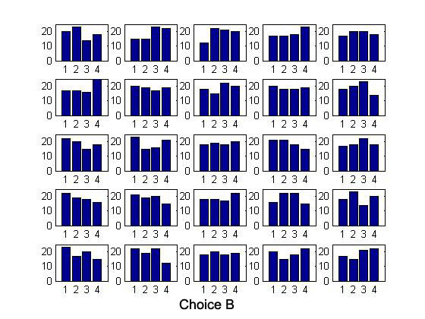

Slide 2
350
My First MT Cell
300
250
200
response (spikes/sec)
150
100
50
0
-50
0
50
100
150
200
250
300
350
direction of motion (deg.)

